Slide 1

MANAGEMENT OF NATURAL RESOURCES
Stake Holders of Forest

Slide 2
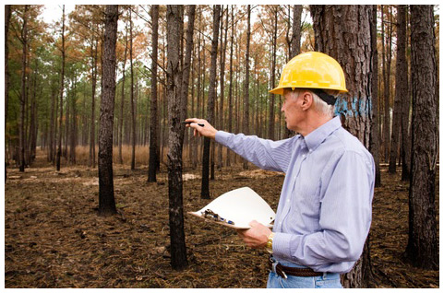
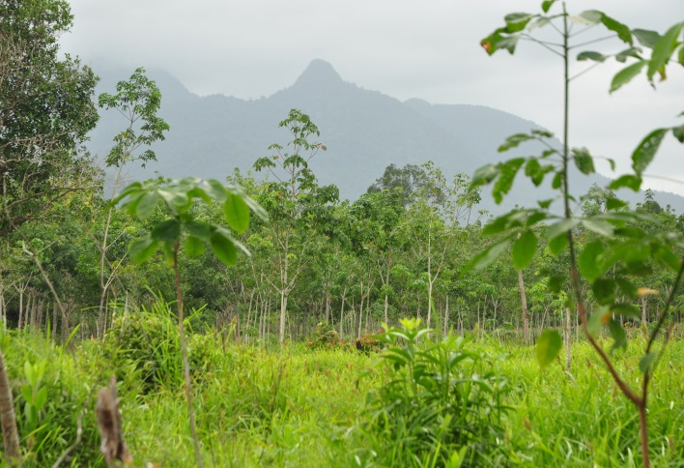
The Forest Department of the Government which owns the land and controls the resources from forests.

Slide 3
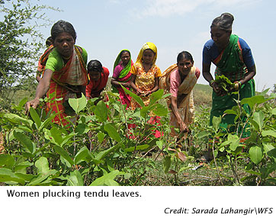
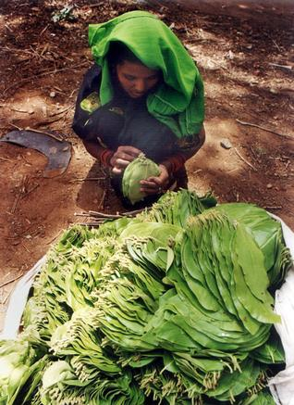
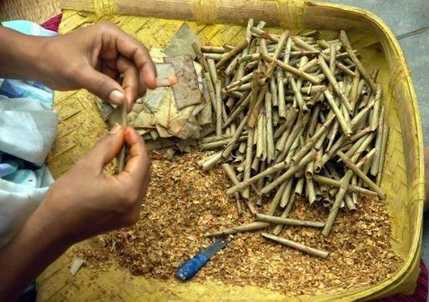
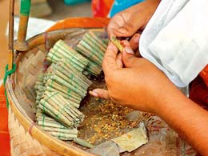
The industrialists – from those who use ‘tendu’ leaves to
make bidis to the ones with paper mills – who use various
forest produce, but are not dependent on the forests in any
one area.

Slide 4
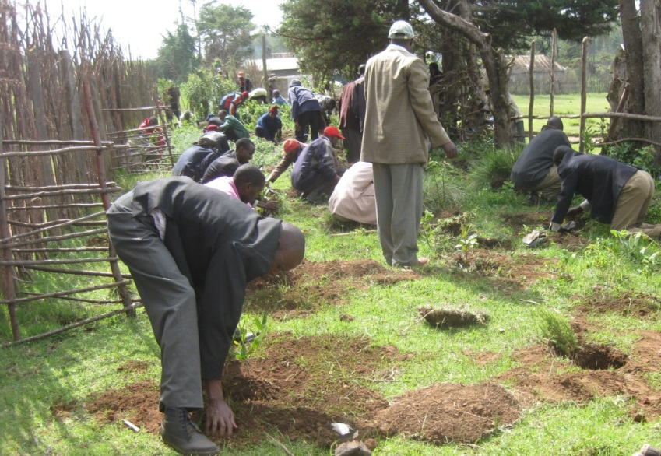
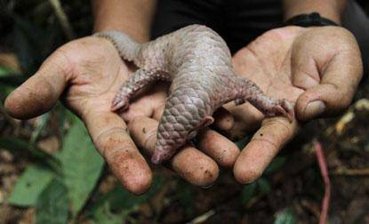
The wild life and nature enthusiasts who want to conserve nature in its pristine form.

Slide 5
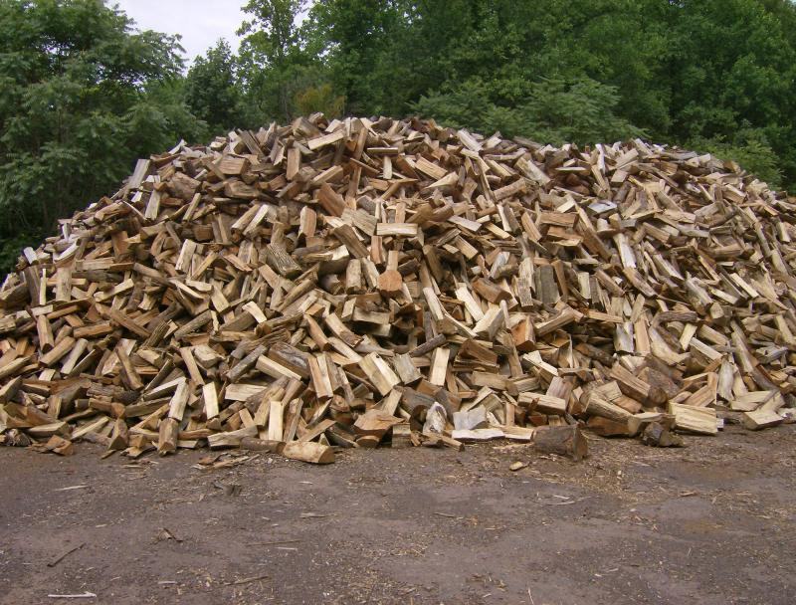
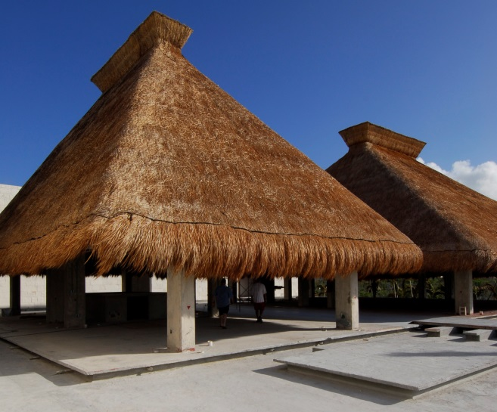
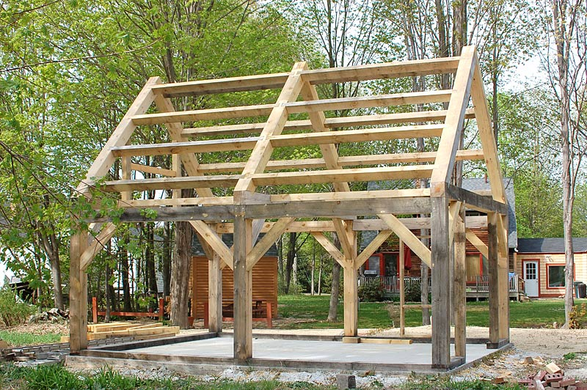
The local people need large quantities of firewood, small timber
and thatch.

Slide 6
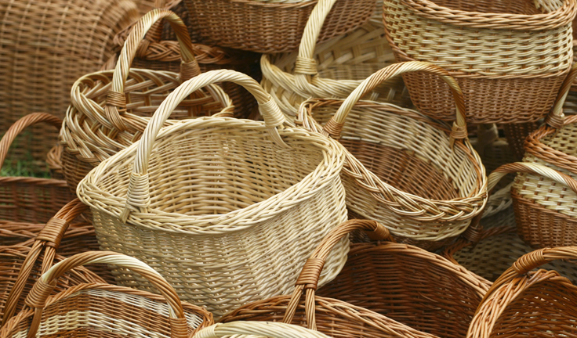
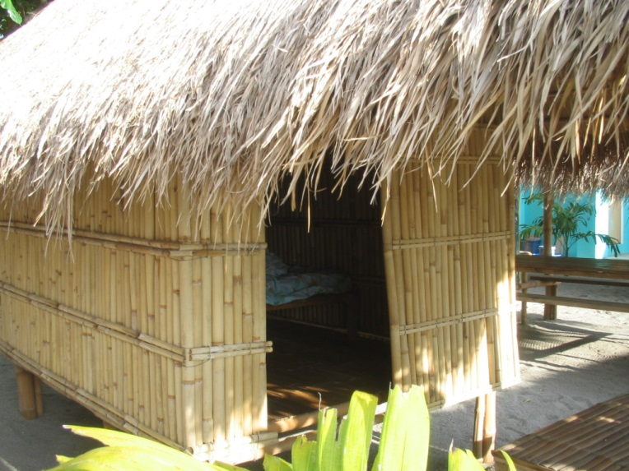
Bamboo is used to make slats for huts, and baskets for collecting and storing food materials.

Slide 7
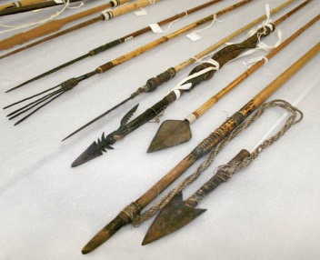
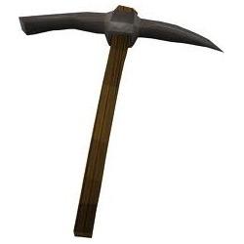
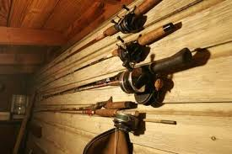
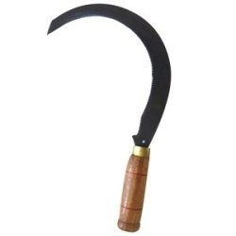
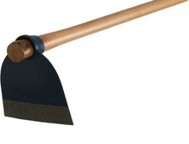
agriculture
Implements for agriculture, fishing and hunting are largely made of wood, also forests are sites for fishing and hunting.
fishing
hunting

Slide 8
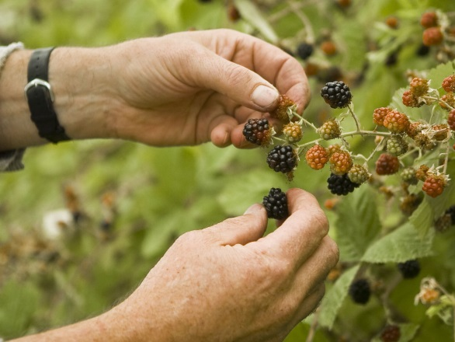
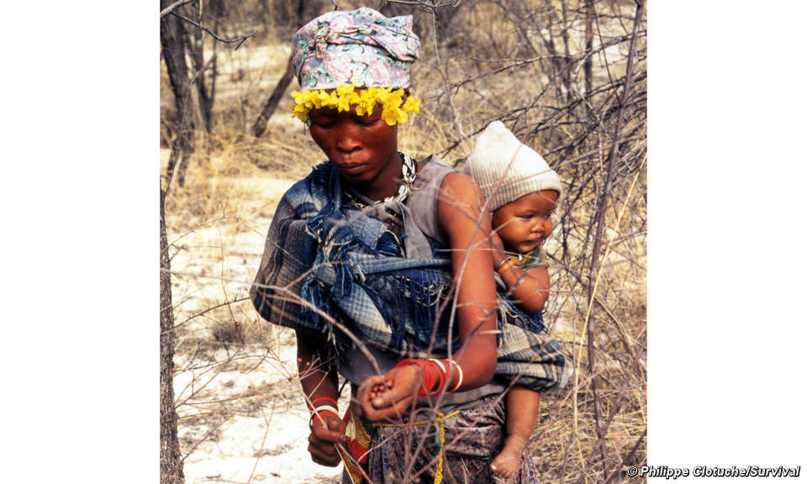
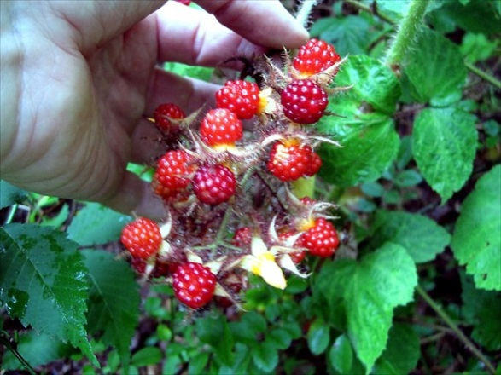
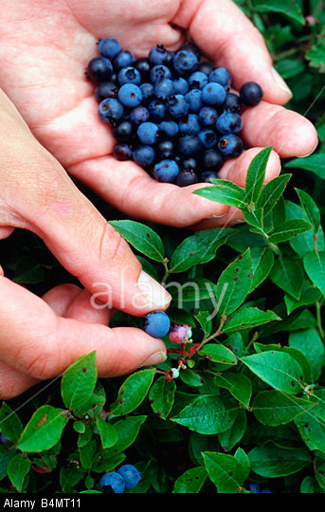
In addition to people gathering fruits, nuts and medicines from the forests, their cattle also graze in forest areas or feed on other fodder which is collected from forests.

Slide 9

Do you think such use of forest resources would lead to the
exhaustion of these resources?

Slide 10
Thank You

